Slide 1
Sandy Spring Slave Museum
&
African Art Gallery
100TH ANNIVERSARY OF THE RATIFICATION
OF THE
19TH AMENDMENT

Slide 2
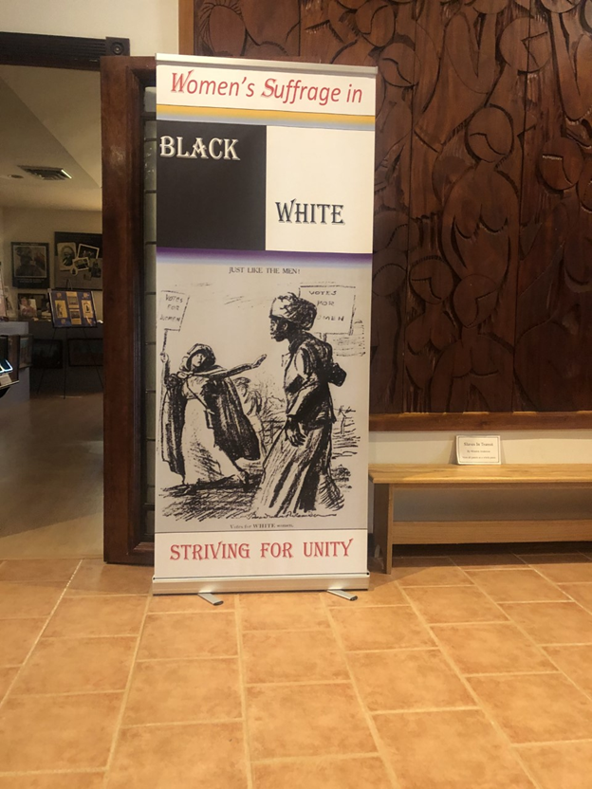
WOMEN’S SUFFRAGE MOVEMENT
The women’s suffrage movement was the struggle for the right of women to vote and run for office and is part of the overall women’s rights movement.
The 19th Amendment to the U.S. Constitution granted American women the right to vote and was ratified on August 18, 1920, ending almost a century of protest.

Slide 3
SENECA FALLS CONVENTION
https://www.youtube.com/watch?v=TcYhuG1y3bc

Slide 4
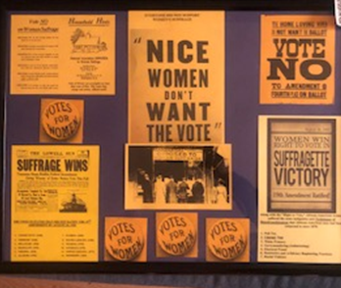
The need for support
https://www.pbs.org/video/womens-suffrage-7neirw/

Slide 5
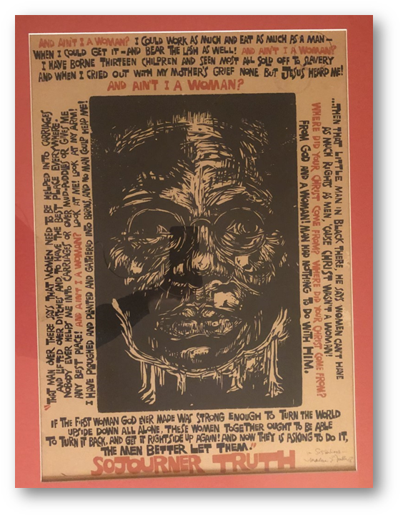
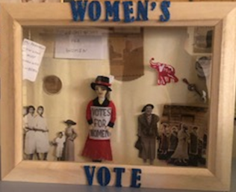
Sojourner Truth
Sojourner Truth
https://www.youtube.com/watch?v=TrVek_dWsmg

Slide 6
NATIONAL ASSOCIATION OF COLORED WOMEN

Slide 7
https://www.youtube.com/watch?v=Br6b9sIuIDU

Slide 8
VICTORY FLAG
The gold-white-purple horizontal tricolor became the flag of the American Suffrage movement. In 1913, Alice Paul and Lucy Burns had founded the “Congressional Unions for Women's Suffrage,” but in 1917 it was named The National Women’s Party (NWP). As the 19th amendment made its way through the approval process, the NWP sewed a star on their “ratification banner” after each state ratified the amendment. They needed 36.
https://www.youtube.com/watch?v=ML76y8mACZs

Slide 9
The Right to Vote
1920-2020
100 Years

