Slide 1
The Sandy Spring Slave Museum
Education Program

Slide 2
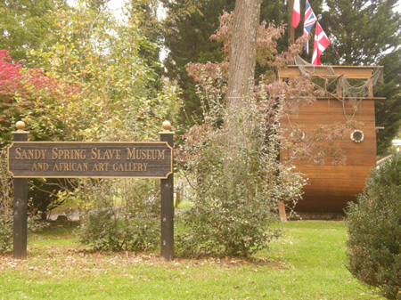
The Sandy Spring Slave Museum offers an educational program that encourages students to gain an awareness of the rich history of their community. Students will be able to think critically as they analyze, synthesize and evaluate historical aspects from Africa to the United States through the following periods of African Americans.
Diaspora
Middle Passage
Underground Railroad
Emancipation
Free Settlements
Civil Rights

Slide 3
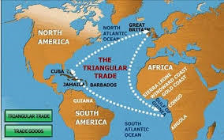
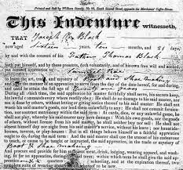
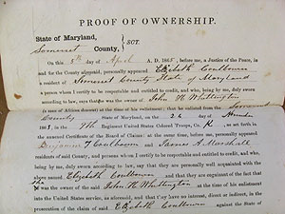
Slavery comes to the United States
Students will be able to
Express thoughts and feelings of those who endured the middle passage
Compare and contrast Indentured Servitude and Slavery

Slide 4
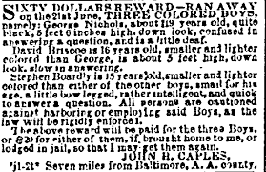
Resistance
Students will be able to
Identify what and who were Abolitionist and what was their impact on Slavery in Sandy Spring
Identify signs and symbols along the Underground Railroad
Critique the pros and cons of the Underground Railroad

Slide 5
Manumission vs. Emancipation
Students will be able to
Distinguish the difference between the two legal means to freedom
Explain the impact of the Emancipation Proclamation on Slavery in Maryland compared to Slavery in the Rebellious States

Slide 6
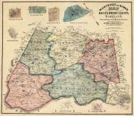
Free Settlements
Students will be able to
Discover the communities within Montgomery County settled by free African Americans.
Summarize opportunities for African Americans within those communities

Slide 7
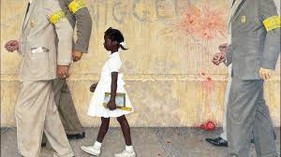
Education
Students will be able to
Summarize educational opportunities for African Americans
Explain educational opportunities for African Americans prior to Separate but Equal
Sharp Street
Kinship Community Schools
Rosenwald Schools
High Education
Examine how landmark cases impacted education for African Americans
Plessy vs. Ferguson Separate but Equal 1896
Brown vs. Board of Education 1954

Slide 8
Significant Community Members
Students will be able to
Identify the people, both black and White, who impacted various aspects of African American life

Slide 9
Occupations
Students will be able to
Describe the types of jobs available to African Americans
Enslaved
Freemen

Slide 10
Religion
Students will be able to
Identify and locate the religious organizations that impacted Slavery on both enslaved and free African Americans.
Society of Friends (Quaker Meeting 1753)
Sharp Street- 1820
St. Bartholomew’s Church- 1812

Slide 11
Social Life and Well-Being
Student will be able to
Identify how African Americans in Sandy Spring provided social opportunities for community members
Church events
Odd Fellows Lodge
Sporting Events/activities
State Fair
Mercedes Club

Slide 12
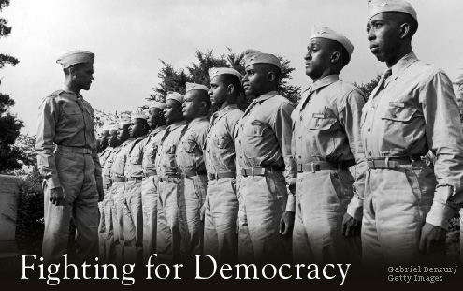
Military Service
Students will be able to
Describe the opportunities African Americans had within the military
Jobs
Rank

Slide 13
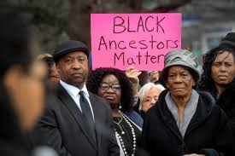
Contributors to African American Culture
Students will be able to
Identify how African Americans contributed to the culture of the United States
Entertainment
Music/poetry/Literature/Dance
Athletics/Sports
Politics

